Slide 1

WIRELESS V2V COMMUNICATIONS OF UNMANNED VEHICLES WITH WIRELESS NETWORK TRACKING AND EMP CHARGER OF TESLA COIL
PAAVAI ENGINEERING COLLEGE (Autonomous)
Guided by Presented by
Dr.M.Sudha M.E.,MBA.,(Ph.D) P.Santhosh (16105124)
R.SivaPrakash (16105132)
M.Surya (16105146)

Slide 2

OBJECTIVE
The main objective of this project is to avoid accidents and to improve the traffic flow in an eco-friendly way.

Slide 3
EXISTING SYSTEM
Vehicle-to-vehicle communications, a system designed to transmit basic safety information between vehicles to facilitate warnings to drivers concerning impending crashes. Wireless power transmission is used for charging.
Paavai Engineering College - Department of ECE

Slide 4
PROPOSED SYSTEM
Cost-effective wireless connectivity for devices without infrastructure coverage
Transmit messages such as vehicle’s speed, heading, brake status, and other information to other vehicles
Receive the same information from the messages
Frequency generator and the booster amplifier is used in the transmitter and receiver side to improve the efficiency.
Paavai Engineering College - Department of ECE

Slide 5
LITERATURE COMPARISION
TITLE | TECHNIQUE | DRAWBACKS
3 D real time simulation for autonomous driving for vehicle to vehicle communication | The main purpose of this paper is to demonstrate a 3D real time traffic simulator using Vehicle to vehicle communication, traffic and congestion for autonomous vehicles | Automated traffic light controller is needed in advance.The vehicle driving algorithm needs to be sharpened
Analysis of protocol stack with Vehicle to vehicle and infrastructure communication | The Vehicle to vehicle and infrastructure communication dedicated short range communication are used to avoid the chances of collision and to improve traffic flow | Signal fading occurs, High error rate
Two way Laser Radar Visible Light Bidirectional Communication | The main objective of this paper is to increase ranging accuracy, energy efficiency and safety .This involves laser radar visible light boomerang system using time hopping spread spectrum technique | Due to external factors like reflection of light they get collapsed
Paavai Engineering College - Department of ECE

Slide 6
LITERATURE REVIEW (Contd..)
Vehicle to Vehicle communication | The concept of this paper is to improve traffic flow and avoid accidents with the help of vehicular Adhoc network , Zigbee for communication and Ultra wide band to transfer data | Latency, Interoperability problem.
Cognitive radio technology for Unmanned Aerial Vehicle communication | The cognitive radio and spectrum sharing techniques are used to overcome the spectrum scarcity in wireless networks which enables the Vehicle to vehicle communication | Response time in an unmanned vehicle is a critical issue
Vehicle collision avoidance system in networks | The main aim of this paper is to reduce the chances of collision by using Vehicular AdHoc Network. Intelligent control unit and vehicle to vehicle communication are used to predict the probability of collision | Real time road condition is not achievedLatency and delay time occurs
Wireless power transmission solid state tesla coil | The main objective of this paper is to demonstrate wireless power transmission by generating high voltage and high frequency electrical power using Tesla coil through magnetic induction devices | Voltage loss occurs during the transmission and reception
Paavai Engineering College - Department of ECE

Slide 7
LITERATURE REVIEW (Contd..)
Path planning of unmanned aerial vehicle with terrestrial wireless network tracking | The purpose of this paper is to determine the path of autonomous UAVs with permanent tracking capabilities, avoiding collision and to reduce the delay time using deterministic and Heuristic algorithm | Once the signal is lost in offline we need to be online to find the path
Trajectory planning for autonomous vehicle in uncertain environment using evidential grid | The aim of this paper is to provide the effective path for the autonomous vehicle by sensing the surrounding environment with the help of Evidential grid, probabilistic and randomized algorithm | This approach does not predict the other vehicles position
Design of tesla coil and its uses in wireless power transmission | This paper includes the design and construction to transmit power through space using high voltage Tesla coil | Voltage loss occurs High voltage will affect the system
Paavai Engineering College - Department of ECE

Slide 8
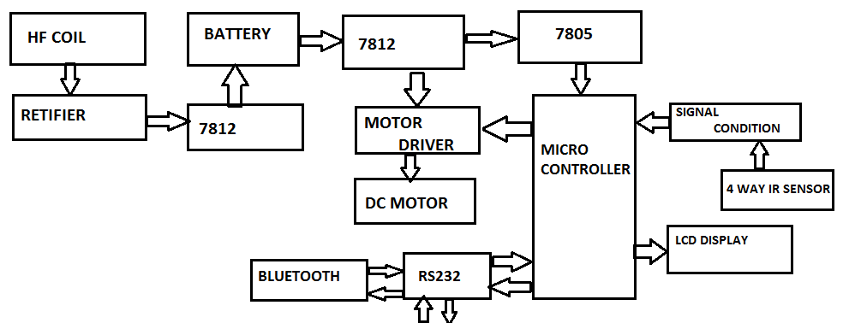
PROPOSED DIAGRAM
RF
Paavai Engineering College - Department of ECE

Slide 9
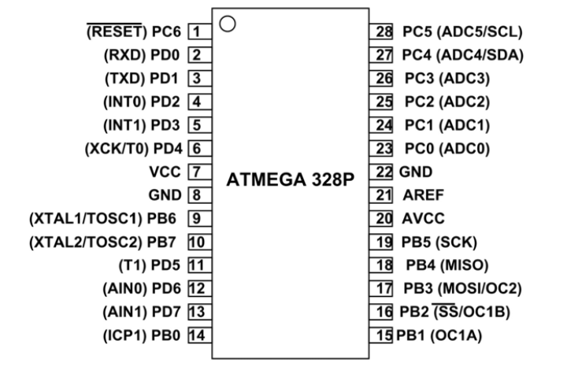
EXPLANATION
ATMEGA 328
It is a single chip micro controller created by ATm ega in the mega AVR. It is a 8 bit RISC processor core. It has 32 general purpose registers. It consists of 28 pins.
SPECIFICATION | RANGE
CPU | 8 bit AVR
Flash memory | 32 kb
SRAM | 2 kb
EEPROM | 1 kb
Operating frequency | 20 MHz
Operating Voltage | 1.8-5.5 V
Paavai Engineering College - Department of ECE

Slide 10
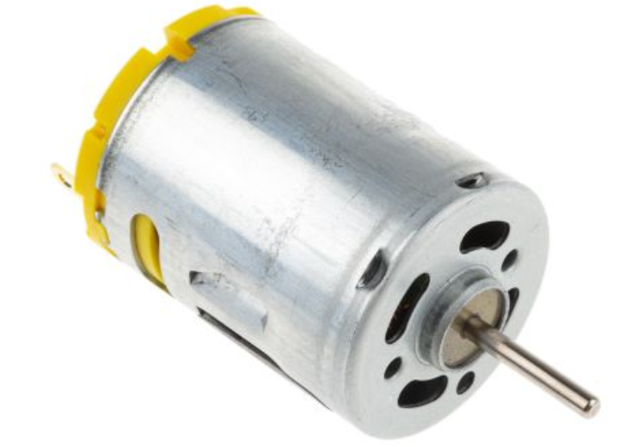
EXPLANATION
DC MOTOR
Device that converts electrical energy or other energy into mechanical energy or imparts motion. A direct current motor is a fairly simple electric motor that uses electricity and a magnetic field to produce torque, which turns the rotor and hence give mechanical work. It is used as a wheel to drive the car. Here we are using 12V DC voltage
SPECIFICATION | RANGE
Operating Voltage | 6,12,24 V
Paavai Engineering College - Department of ECE

Slide 11
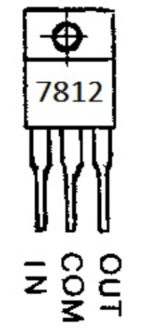
EXPLANATION
VOLTAGE REGULATOR
It provides a regulated output voltage from a unstable or fluctuating input voltage supply. It can handle maximum of 1 amphere current. It is used to give constan 12V power supply to the micro controller
SPECIFICATION | RANGE
Series | 7805
Input voltage | < 1.5 V
Output voltage | 5 V
Paavai Engineering College - Department of ECE

Slide 12
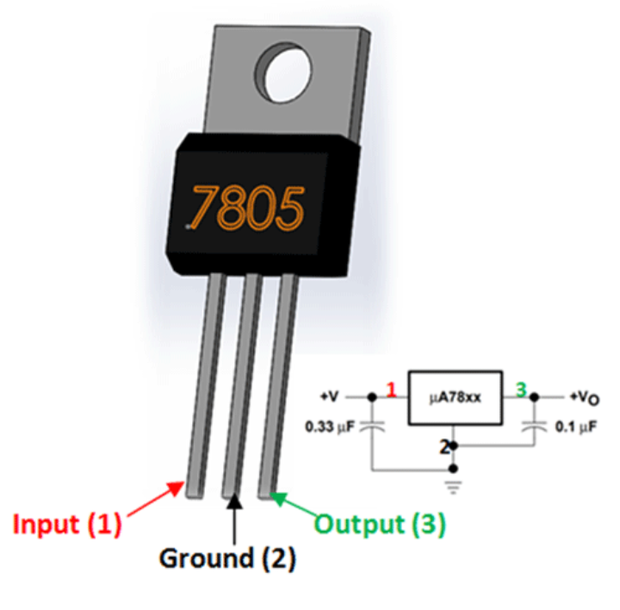
EXPLANATION
VOLTAGE REGULATOR
It provides a regulated output voltage from a unstable or fluctuating input voltage supply. It can handle maximum of 1 amphere current.
SPECIFICATION | RANGE
Series | 7812
Input voltage | 14.6-35 V
Output voltage | 12 V
Current output | 1.5 A
Paavai Engineering College - Department of ECE

Slide 13
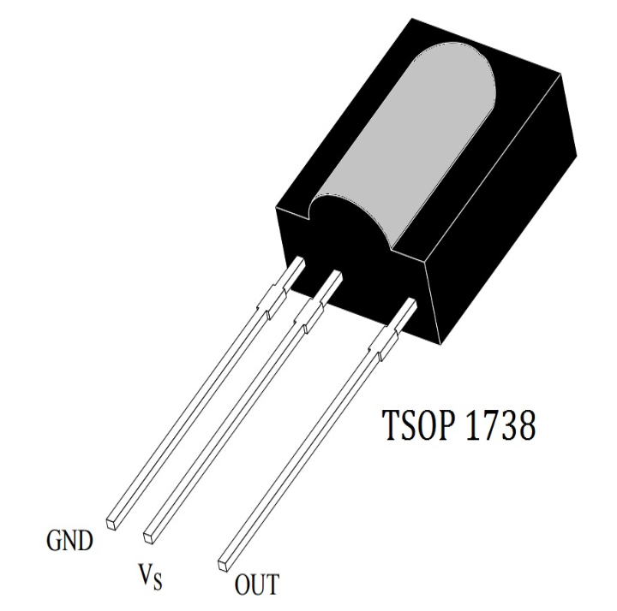
EXPLANATION
IR RECEIVER
It can detect IR signals
High range and wide area coverage
Respond only to the IR signals
Low power consumption
SPECIFICATION | RANGE
Input Voltage | -0.3 - 5 V
Operating Current | 5 mA
Receivng frequency | 38KHz
Paavai Engineering College - Department of ECE

Slide 14
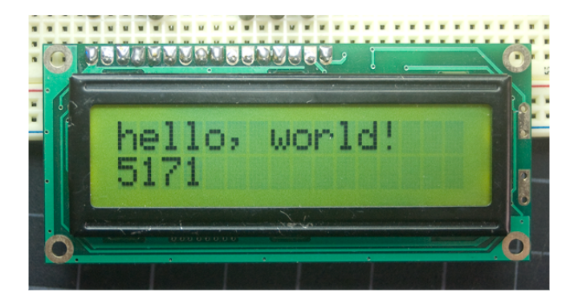
EXPLANATION
LIQUID CRYSTAL DISPLAY
It is a liquid crystal dislay information. There are two working modes namely 4 bit and 8 bit. Here 4 bit is used to display the gathering information such as speed of the car, direction etc
SPECIFICATION | RANGE
operating voltage | 4.7 to 5.3 V
Current consumption | 1 mA
Available colour | Green & Blue backlight
Working mode | 8 bit & 4 bit
Paavai Engineering College - Department of ECE

Slide 15
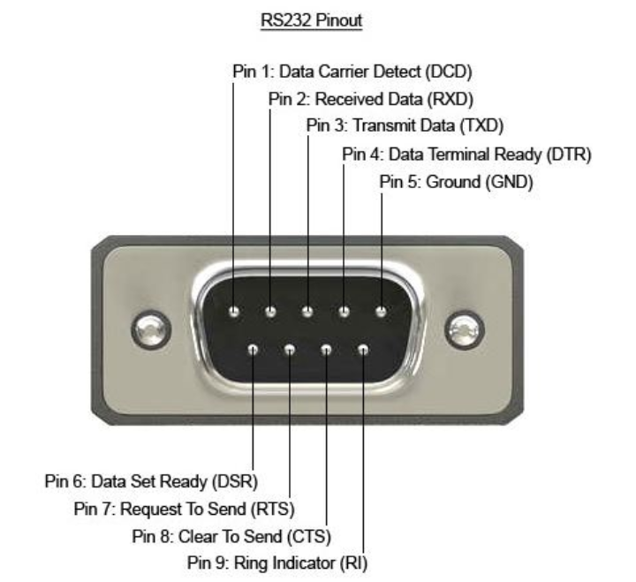
EXPLANATION
RS 232
It is used for connecting pheripheral devices to allow serial data exchange between them. It is used to connect bluetooth and RFID to micro controller.
SPECIFICATION | RANGE
Communication range | 1.492 Kbps
Maximum cable meter | 15 meters
Maxium open circuit voltage | 25 V
Line impedance | 30 to 70 hms
Paavai Engineering College - Department of ECE

Slide 16
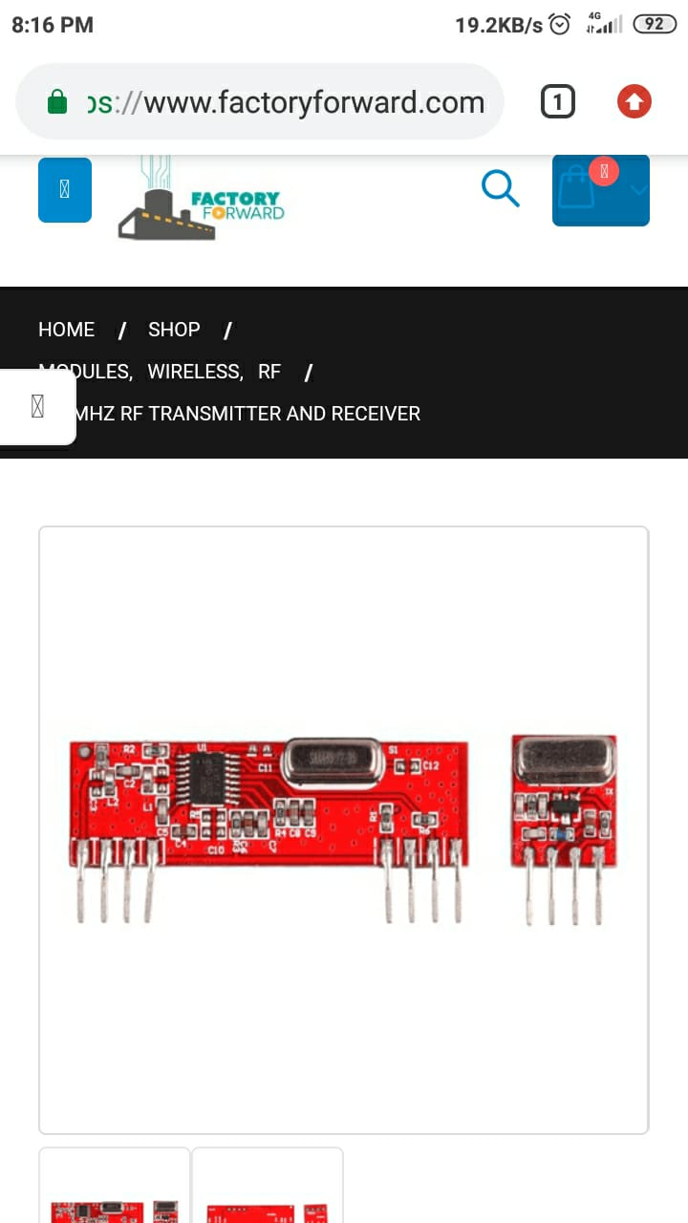
EXPLANATION
RF MODULE
The 433MHz is a wireless module, used only in pairs. The Transmitter can only transmit information and the receiver can only receive it. Thus the data can be send from point A to B.
SPECIFICATION | RANGE
Power supply | (3-12)V
Operating Current | 5.5 mA
Transmission distance | 3 meters
Modulating Technique | ASK
Operating Fequency | 433MHz
Paavai Engineering College - Department of ECE

Slide 17
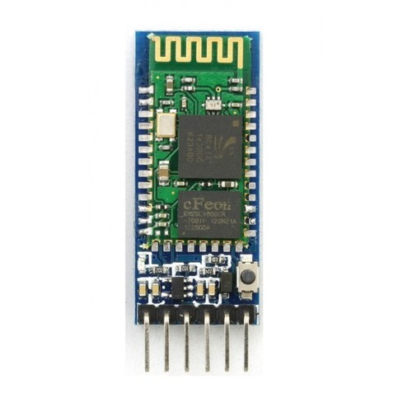
EXPLANATION
BLUETOOTH MODULE
HC-05 is a Bluetooth module which is designed for wireless communication. This module can be in a master or slave configuration.
SPECIFICATION | RANGE
VCC | 5 or 3.3 Volt
GND | Ground pin of module
TXD | Transmits data
RXD | Receives data
State | Tells whether moduleis connected or not
Paavai Engineering College - Department of ECE

Slide 18
HARDWARE REQUIREMENT
Microcontroller
Crystal
Resistors
Capacitors
Diodes
Regulator
Transistors
Lcd display
Keypad
DC Motor
ZIGBEE
Bluetooth
RS232
IR Sensor
Level Switch
Paavai Engineering College - Department of ECE

Slide 19
SOFTWARE REQUIREMENT
Embedded C
Code Vision AVR
AVR Kit 2
Paavai Engineering College - Department of ECE

Slide 20
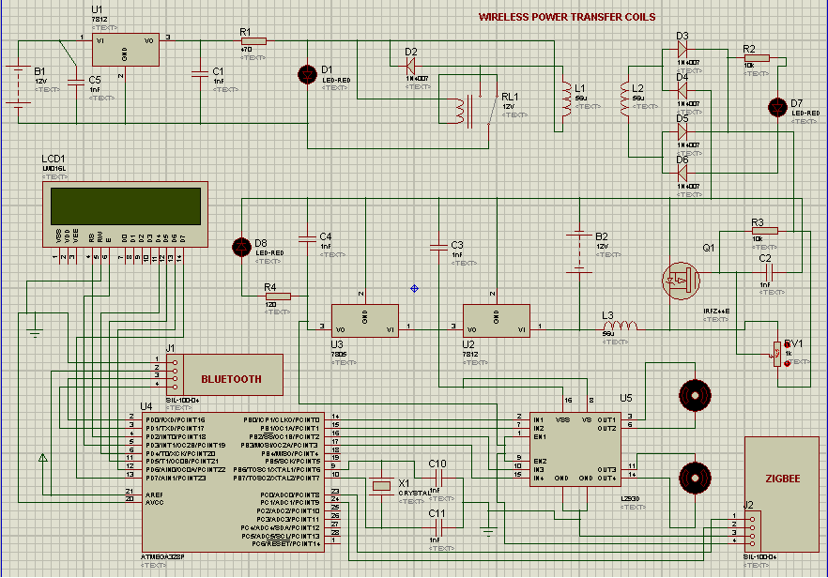
SIMULATION OUTPUT
Paavai Engineering College - Department of ECE

Slide 21
RESULT AND DISCUSSION
Safety is considered an important concern while driving vehicles and it should be eco-friendly and maintain the traffic flow
In this project we have designed a vehicle with technologies such as Vehicle to Vehicle communication, wireless network tracking and wireless charging using tesla coil
Vehicle to Vehicle communication is used to establish communication between the vehicles
Paavai Engineering College - Department of ECE

Slide 22
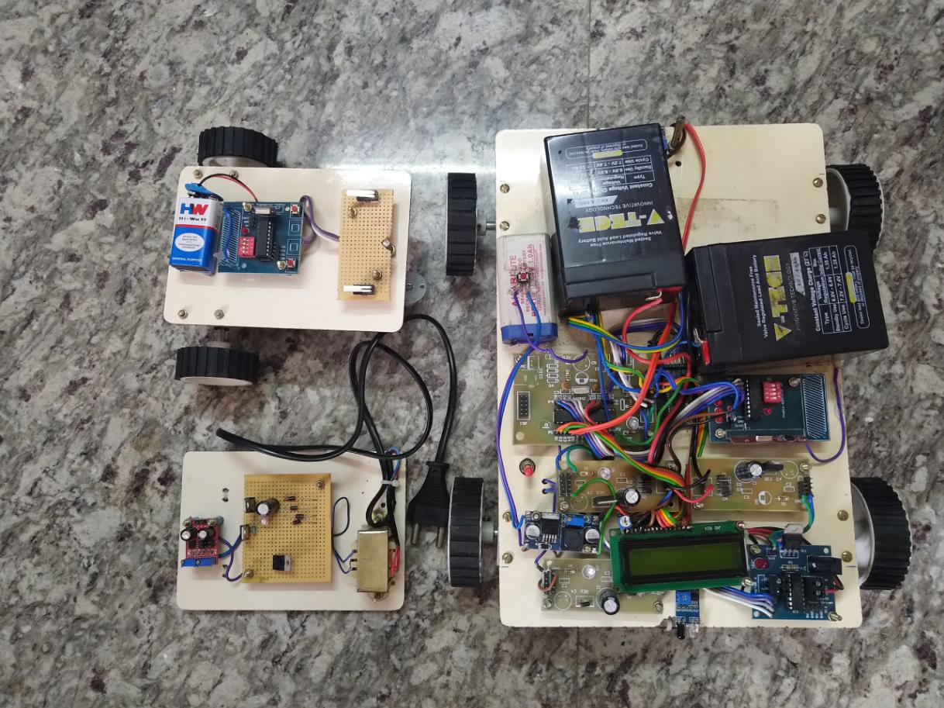
HARDWARE OUTPUT
Paavai Engineering College - Department of ECE

Slide 23
CONCLUSION AND FUTURE ENHANCEMENT
Vechile to vehicle technology is used to establish communication between the vehicles when they are the certain distance
The electrical car concept to go through a eco friendly way
The concept of Telsa’s wireless charging is used to charge the vehicle
The future enhancement of the project will be the vehicle with levitating technology
Paavai Engineering College - Department of ECE

Slide 24
REFERENCES
[1] K. P. Valavanis and G. J. Vachtsevanos, Handbook of Unmanned Aerial Vehicles, Springer Netherlands, 2015.
[2] US Department of Transportation, “Unmanned Aircraft System (UAS) Service Demand 2015–2035: Literature Review & Projections of Future Usage,” tech. rep., v.0.1, DOT-VNTSC-DoD-13-01, Sept. 2013.
[3] A. Merwaday and I. Guvenc, “UAV Assisted Heterogeneous Networks for Public Safety Communications,” Proc. IEEE Wireless Commun. Net. Conf., 9–12 Mar. 2015, pp. 329–34.
[4] A. Osseiran et al., “Scenarios for 5G Mobile and Wireless Communica- tions: the Vision of the METIS Project,” IEEE Commun. Mag., vol. 52, no. 5, May 2014, pp. 26–35.
[5] E. W. Frew and T. X. Brown, “Airborne Communication Networks for Small Unmanned Aircraft Systems,” Proc. IEEE, vol. 96, no. 12, Dec. 2008, pp. 2008–27.
[6] N. Goddemeier, K. Daniel, and C. Wietfeld, “Role-Based Connectivity Man- agement with Realistic Air-to-Ground Channels for Cooperative UAVs,” IEEE JSAC, vol. 30, no. 5, June 2012, pp. 951–63.
Paavai Engineering College - Department of ECE

Slide 25
REFERENCES
[7] T. S. Rappaport et al., Millimeter Wave Wireless Communications, Prentice Hall, 2014.
[8] R. Sun and D. W. Matolak, “Initial Results for Airframe Shadowing in L- and C-Band Air-Ground Channels,” Proc. Integrated Commun., Nav- igation, and Surveillance Conf., Apr. 2015, pp. 1–8.
[9] Z. Han, A. L. Swindlehurst, and K. J. R. Liu, “Optimization of MANET Con- nectivity via Smart Deployment/Movement of Unmanned Air Vehicles,” IEEE Trans. Vehic. Tech., vol. 58, no. 7, Sept. 2009, pp. 3533–46.
Paavai Engineering College - Department of ECE

